Slide 1

Coal: Social, environmental and economic concerns
Francesco Gardumi
gardumi@kth.se
Introductory lecture – Energy commodities and technologies
This work by OpTIMUS.community is licensed under the Creative Commons Attribution 4.0 International License. To view a copy of this license, visit http://creativecommons.org/licenses/by/4.0/.

Slide 2
Commodity: global trends
Demand
Supply
Resources

Slide 3
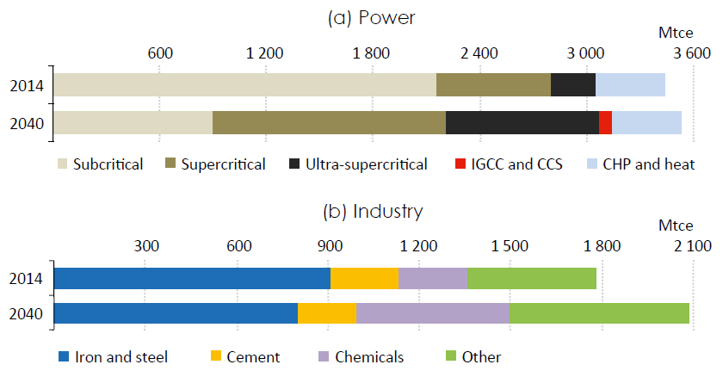
Demand
World coal demand by key sector in IEA New Policies Scenario
Source: IEA World Energy Outlook 2016.
Notes:
No significant growth in the power sector; the plant technology changes the structure of the demand (shifting from subcritical to the more efficient supercritical). Chemicals are the main driver for the demand growth in the industrial sector.

Slide 4
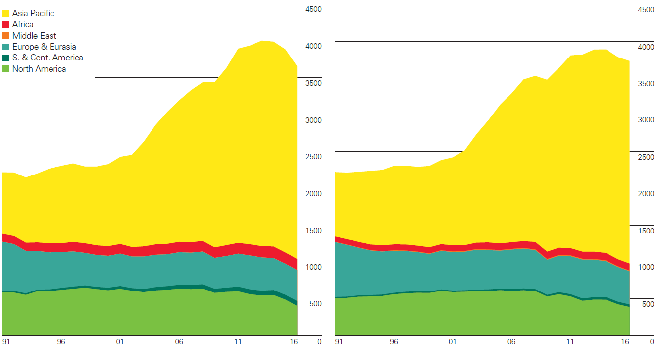
Supply
Coal production (Mtonned oil equivalent) Coal consumption (Mtonnes oil equivalent)
Source: BP Statistical review of World Energy 2017.

Slide 5
Resources
Coking coal: derived from bituminous coal, by destructive distillation. It is hard and dark/greyish, it has few impurities and high carbon content and it is used particularly as a fuel in the industry (e.g. iron).
Steam coal: (also called thermal coal) all other hard coal that is not Coking coal. It is commonly used for power and heat generation, ground to a powder.
Lignite: (often called brown coal) soft coal with relatively low carbon content (60-70%), derived from compressed peat. Mostly used for power generation, but also for gasification and in ammonia-based fertilizers.

Slide 6
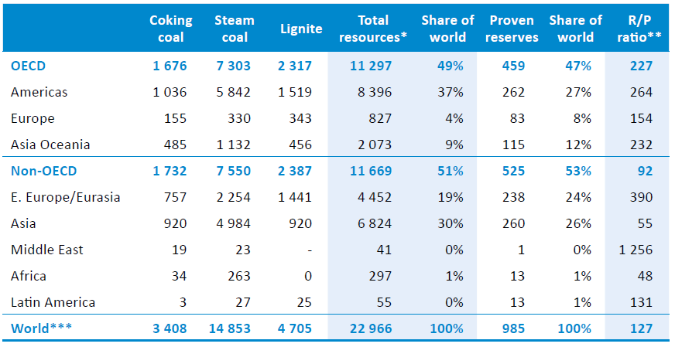
Resources
Proven reserves = 90% probability to be extracted profitably
Coal resources (billion tonnes)
Source: IEA World Energy Outlook 2016.
Notes:
These figures haven’t changed significantly since IEA World Energy Outlook 2015.
The reserves to production ratio (R/P) represents the length of time that proven reserves would last if production was to continue at current rates.

Slide 7
Technologies in the coal chain
Mining and preparation
Transportation
Gasification
Combustion-based power plants
Economic, Environmental and Social concerns

Slide 8
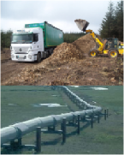

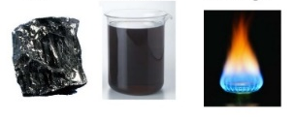
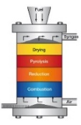


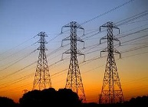

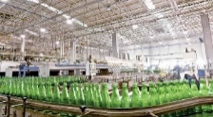
Sample Reference Energy System
Import / Extraction+processing of fossil fuels
Fuel transportation
Refinery
Energy demand
Transportation sector
Coal
Coal
Gasification
Combustion-based
power plant
Coal
Energy demand
Residential sector
Syngas
Electricity
Electricity transmission and distribution
Energy demand
Commercial sector
Energy demand
Industrial sector

Slide 9
Mining and preparation
Key characteristics
Capital cost | 51.3-7155 M$
FOM cost | -
VOM cost | 14.3-71.6 $/t
Energy use | 0.391 GJ/ton mined
CO2 Em. factor | 5.1-10.1 kgCO2eq/GJ
Two mining methods exist:
Undergroung mining: it accounts for 60% of mining worldwide and includes 1) room-and-pillar methods, 2) long-wall methods
Surface mining: used in Australia and US, particularly
The preparation (or cleaning) consists in removing impurities, such as sulphur, ashes and rocks. Two main methods:
Physical cleaning: most used, mechanical separation based on density.
Chemical cleaning: more expensive.

Slide 10
Transportation
Key characteristics
Sample values for maritime vessels
Capital cost | -
FOM cost | -
VOM cost | 0.1-0.9 $/GJ
Energy use | -
CO2 Em. factor | 5-16 gCO2/ton-km
It accounts for a large part of the total cost of the delivered product. It usually occurs via:
Railways;
Barges on inland waters;
Large vessels through oceans;
Pipelines as a mixture of coal and water;
Trucks (for short distances).

Slide 11
Gasification
Key characteristics
Capital cost | 13.5-17.2 $/GJ output
FOM cost | 0.7-1 $/GJ output
VOM cost | 1.4-1.6 $/GJ output
Fuel cost (coal) | 0.9-1.3 $/GJ
Availability | 90%
Lifetime | 20
Efficiency | 73-75%
CO2 Em. factor | 55 kt/PJ
Used for coal, biomass and oil residues. It produces ‘syngas’ rich in H2, CO, CO2. Core process is pyrolysis, i.e. oxydation at T>400 C under Oxygen shortage. Main technologies:
Moving-bed: oldest and simplest, with fuel slowly moving downwards for gravity and being oxydized. High steam consumption.
Fluidized bed: fuel and oxydizer moving upwards together. Faster, but output more impure.
Entrained flow: fuel and oxydizer moving downwards together. Highly pure output.

Slide 12
Combustion-based power plants
Key characteristics
U-SCPC
Capital cost | 2200 $/kW
VOM and FOM cost | 88 $/kW/a
Capacity Factor | 75-80%
Efficiency | 46%
CO2 Em. factor | 730-850 kg/MWh
IGCC
Capital cost | 3700 $/kW
VOM and FOM cost | 148 $/kW/a
Capacity Factor | 75-80%
Efficiency | 46%
CO2 Em. factor | 700-750 kg/MWh
Two main technologies dominate the scene of coal-fired power supply, and they traditionally cover base load:
Super-critical pulverised coal (SCPC) or its evolution, Ultra-Super-Critical pulverised coal (U-SCPC). It is like a traditional steam cycle, where the steam is brought to super-critical conditions.
Integrated Gasification Combined Cycle (IGCC). Here, the coal undergoes a gasification reaction and is turn into a gaseous mixture of H2, CO2 and CO. The gas is then burnt in a Gas Turbine and the exhaust feeds a Heat Recovery Steam Generator (HRSG).
Carbon Capture and Sequestration (CCS) can be applied.

Slide 13
What more could you want in a fuel… Right?
Abundant
Relatively inexpensive
Simple to extract and transport
Mature technology for power generation
Located in politically stable regions and abundant in many countries
Price not determined by ‘cartels’ – but by industry consumers (mining, steel, power…)
BUT
Extremely polluting, adversely affecting the most critical life-sustaining systems on the planet (air, water, land)

Slide 14
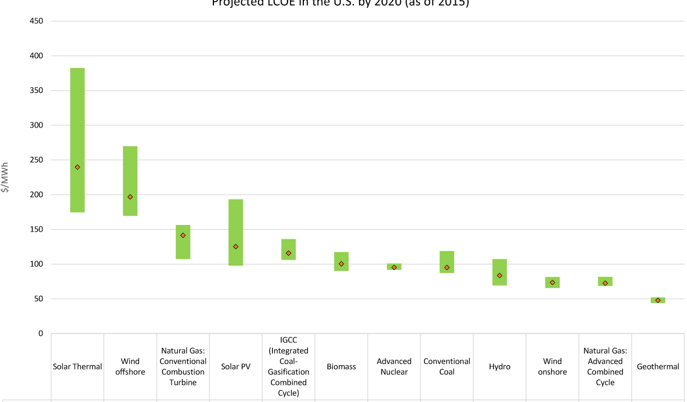
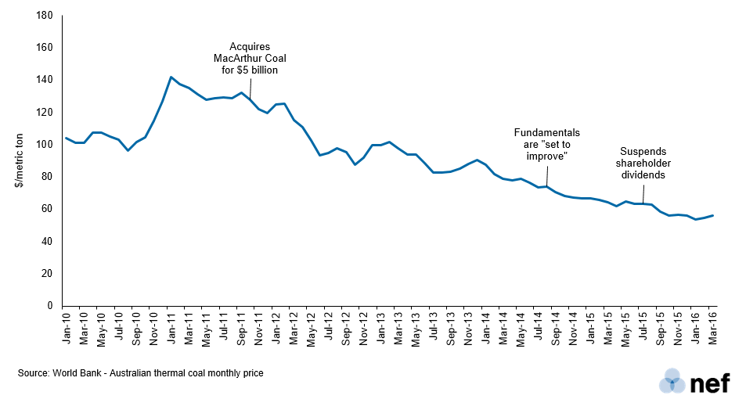
Economic concerns
Cheapest source of energy
Coal pollution costs the EU €43 billion each year (health impacts from especially air pollution)
Carbon pricing and regulation are imperative to control pollution and limit generation from inefficient units.

Slide 15
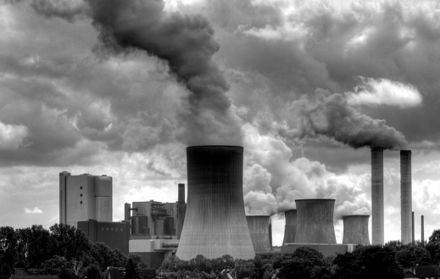
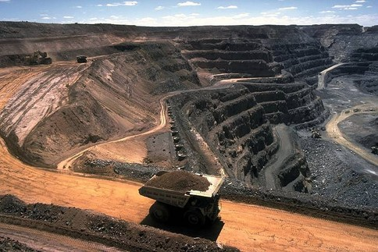
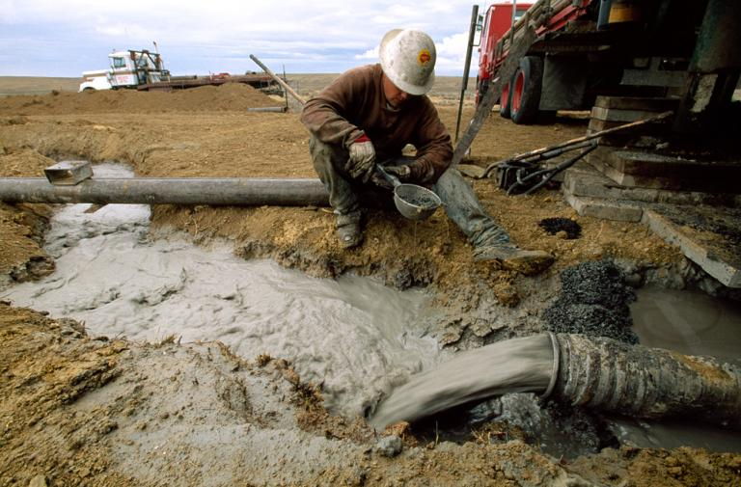
Environmental and social concerns
Climate
Land-use
Water
Source: Grist, davipt
Source: Top News
Source: National Geographic
The combustion of coal is the largest contributor to the human-made increase of CO₂ in the atmosphere.

Slide 16
Environmental and social concerns
Climate/Air | Land-use | Water
CO₂ emissions | Degradation of vegetation | River water alkalinity (and ‘sodicity’ – sodium salts)
SO₂-related acidification of ecosystems | Loss of wildlife habitats | Fly ash stored in impoundment ponds
Mercury emissions (concentration at higher levels of food chain) | Damage due to mine collapses | Degradation of aquatic habitats
Acid rain | Loss of topsoil leads to infertile wastelands | Cooling water requirements

Slide 17
Conclusions

Slide 18
The continuing trend of year-on-year growth in coal-fired power needs to be reversed to meet ambitious CO₂ targets.
Policy incentives such as carbon pricing and regulation are imperative to control pollution and limit generation from inefficient units.
New coal power units should achieve best available efficiency and, if not initially installed, should be CCS-ready to have the potential to reduce the impact of coal use

Slide 19
References and reading material

Slide 20
IEA, World Energy Outlook 2016;
British Petroleum, Statistical Review of World Energy 2017. Available at: https://www.bp.com/content/dam/bp/en/corporate/pdf/energy-economics/statistical-review-2017/bp-statistical-review-of-world-energy-2017-full-report.pdf;
IEA-ETSAP, Energy Technology Data Source. Available at: https://iea-etsap.org/index.php/energy-technology-data;
How natural gas could be a geopolitical game-changer in the Mideast: https://www.youtube.com/watch?v=pay5dKYvXGU
Profit Pollution and Deception BP and the Oil Spill: https://www.youtube.com/watch?v=8zGFvzMMO9w&t=706s

Slide 21
Sources for the pictures
Gasification: http://www.gbgasifired.com/model.html
Extraction: http://www.energytrendsinsider.com/research/coal/coal-mining-and-processing/
Refinery: http://stillwaterassociates.com/crack-spread-a-quick-and-dirty-indicator-of-refining-profitability/
Biomass: http://inhabitat.com/tag/biomass/
Renewables: http://www.topnews.in/wind-water-and-sun-beat-biofuels-nuclear-and-coal-clean-energy-297577
Uranium: http://unitednuclear.com/index.php?main_page=product_info&products_id=1028
Fossil: https://www.slideshare.net/MMoiraWhitehouse/fossil-fuels-teach
Combustion based power plants: https://en.wikipedia.org/wiki/Battersea_Power_Station_in_popular_culture
Uranium enrichment: http://energyfromthorium.com/2010/08/06/loveswu1/
Residential: http://jhsimpson.com/residential/
Transport: https://se.123rf.com/clipart-vektorer/transport.html
Industry: http://indianexpress.com/article/business/economy/factory-output-grows-2-per-cent-in-february-after-3-months-of-contraction/
Commercial: http://www.alfalaval.com/industries/refrigeration/commercial-refrigeration/
Transportation of fuel: http://www.zerohedge.com/news/2017-06-23/demand-oil-pipeline-capacity-hits-6-year-low
Transportation of biomass: http://www.forestenergy.ie/transportation-studies.php
Transportation of oil products: http://www.picquery.com/gasoline-truck_WXRZaplkZ2eaRVifu*zjqPAvrMnnxmBsTSgdn*BBBKk/
Decentralized energy supply: http://trayamtechnologies.com/solar-pv-roof-top-and-ground-mounting/
Decentralized energy supply2: http://www.sunwindenergy.com/photovoltaics/38-mw-rooftop-pv-system-completed-uk

Slide 22
Changelog and attribution
Date | Author | Reviewer | Reviser
2017-09-23 | Francesco Gardumi | Francesco Fuso Nerini | Francesco Gardumi
To correctly reference this work, please use the following:
Gardumi, F., 2017. Coal: Social, environmental and economic concerns, OpTIMUS.community. Available at: http://www.osemosys.org/understanding-the-energy-system.html. [Access date]

